Slide 1
The 43rd Annual
Seminar on Seminars
Professor Kenneth S. Suslick
School of Chemical Sciences
University of Illinois at Urbana-Champaign http://suslick.scs.illinois.edu/seminars.html
Coping, Planning, & Organizing
Slide Format
Slide Content
The Presentation
Remote Presentations (see url above)

Slide 2
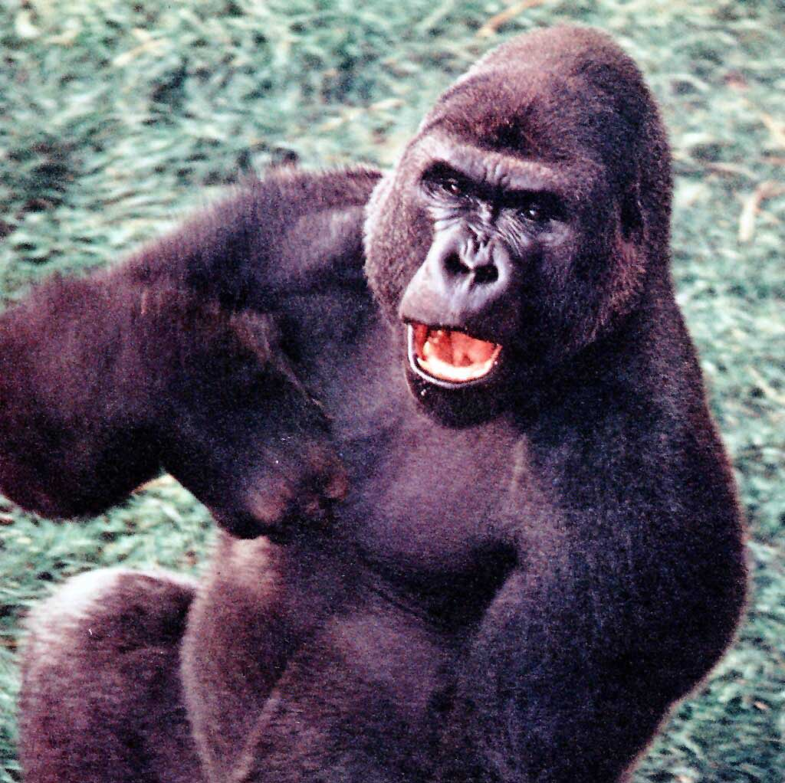
Caveats
Do as I say, not as I do.
This presentation, of necessity,
is word-heavy and graphics-light.
De gustibus non disputandum est.
(There is no arguing about tastes.)
These are my opinions.
I could be wrong, but I’m not.
Snepscheut’s Law:
In theory, there is no difference
between theory and practice.
But in practice, there is.
Monk’s Commentary:
You’ll thank me later.

Slide 3
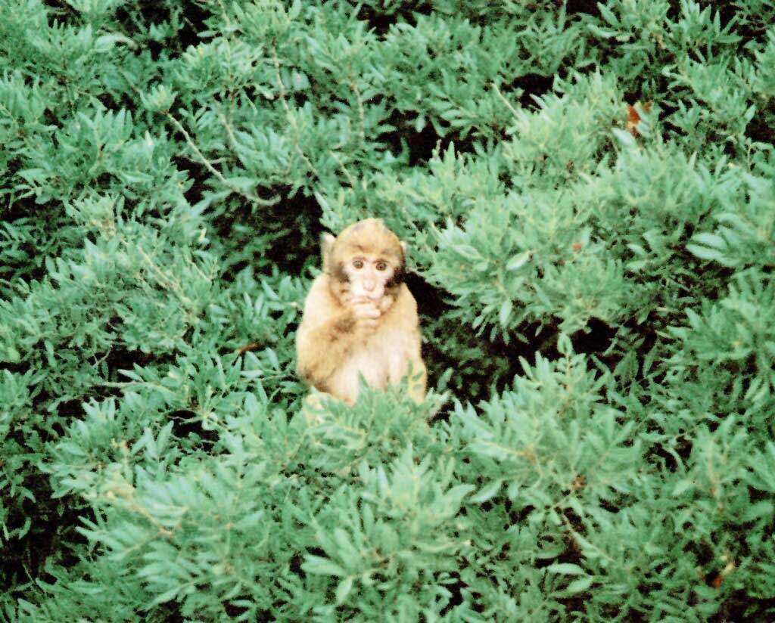
Coping
Public speaking:
very scary for most
students.
“Seminar on Seminars”
–both the big picture and
the devil of the details.
Stress need not be
your enemy.
Eustress
Whelmed
Productivity
Overwhelmed
no pain,
no gain
Stress

Slide 4
Managing Time
If it isn’t worth doing, it isn’t worth doing right! – KSS
Big jobs are like eating an elephant —
one bite at a time: Break the job into small tasks.
Make a to-do list and the list will remember for you.
Last daily chore: 5 min. to plan tomorrow’s day.

Slide 5
Starting and Stopping
Starting is hard due to inertia:
Static friction is greater than dynamic friction.
To overcome procrastination:
Do something, anything!
Do your favorite part, futz with format, just type …
Distractions are tempting due to rate of change.
We’re much more sensitive to slope than position.
Initiative vs. Finishitive:
know when to walk away, know when to run.

Slide 6
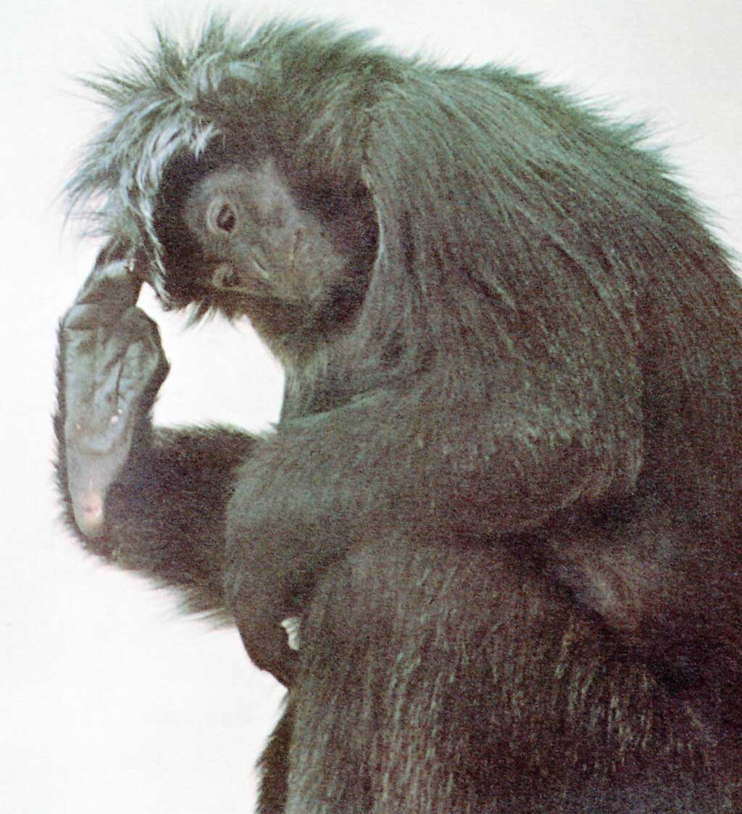
Planning and Organization

Slide 7
The Talk is for your Audience!
Always keep the audience in mind.
You are telling a story.
Tell it so the audience understands.
Stories have context, problem, solution, and results.
What is THE point of your seminar?
Don’t try to tell two stories at the same time!
Why will your audience be interested?
Gear your talk at the right level.
Better to aim just a little low than too high.

Slide 8
Organizing the Talk
To organize your talk:
Graphics & figures first, then words.
An outline lets you think about the logic of the flow.
Number of sub-divisions MUST NOT be 1!
Best if > 2 and < 5.
Verbal comprehension is limited:
Tell them what you are going to tell them,
then tell them,
then tell them what you told them.

Slide 9
Title and Introduction
Short titles are best:
It’s a title, NOT an abstract!
1st slide:
Give the title, your name, and brief outline.
2nd slide:
set the background —
Why should we care about this topic?
What’s the problem, who’s affected, how does
the solution work?

Slide 10
How Many Slides?
Depends on your slides!
Use low content slides and lots of them.
Present only ONE main idea per slide.
Most people ~2 min/slide,
but can be <1 min/slide for images.
Be kind to old fogeys: eyesight declines after 40.
Use big text, high contrast.
Rapid changes in light intensity become painful.

Slide 11
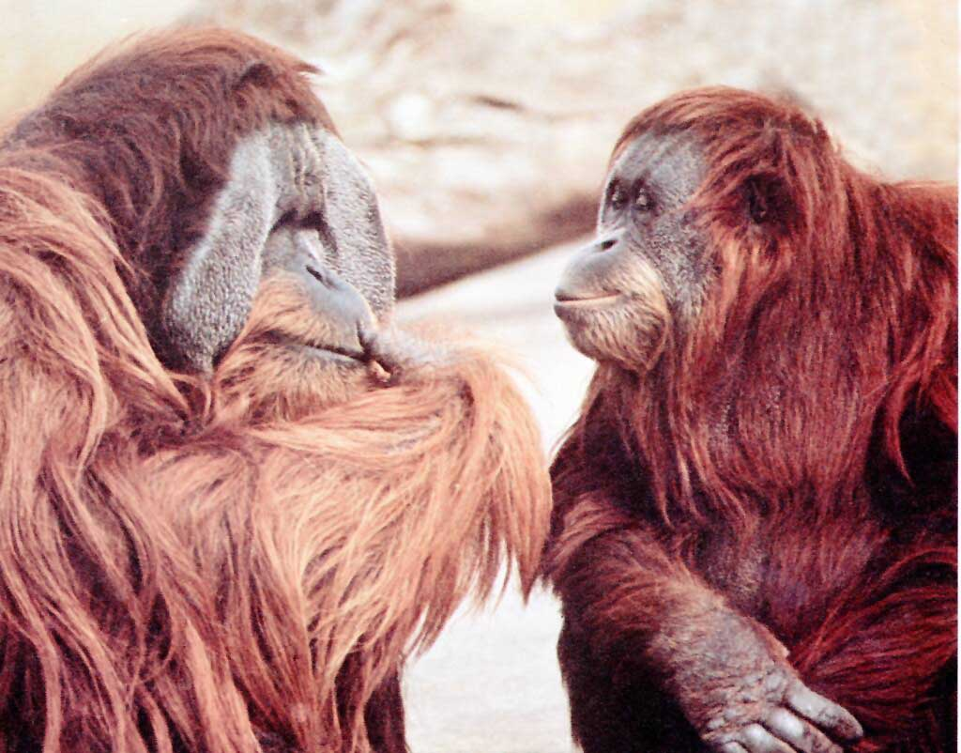
Slide Format

Slide 12
Slides and Keywords
Human beings: visual, not auditory, creatures:
Slides are literally “visual aids”.
You and your audience:
Complementary, but different, needs.
Fewer words better:
keywords, brief prompts, not detailed verbiage.
Make it easy to read: One idea per line.
Don’t break idea or phrase at end of the
line.
(Shift-Enter for manual line breaks.)

Slide 13
Suslick’s Rule of Fist
When you are working on your talk:
You’ll always be too close to the computer monitor.
Strong tendency to over-stuff slides.
Get far enough away from the screen so that,
with your arm fully extended,
your fist blocks the whole slide.
*or make the magnification small enough: <33%
A slide legible at that distance will be
visible even at back of a big hall.
*

Slide 14
General Format
Landscape format is standard. Number slides.
Use page effectively: fill page, but don’t overfill.
Think about blank space:
Spatial separation of ideas, topics, etc.
The natural tendency is to cram things too close together
so that they’ll fit in the space rather than to edit the text to the bare minimum needed;
most people tend to be much too wordy and detailed in their slides, and they then go on and on
and on and on, when what they really should do is just shut up!
Avoid going to the very bottom of the slide:
often not visible to audience.
Last few lines may not be seen!
Last few lines may not be seen!!
Last few lines may not be seen!!!

Slide 15
Font Format: Titles 32 pt. Arial Bold
Avoid serif fonts: don’t use Cambria, Times New Roman, …
Use sans serif fonts: Arial, Calibri, Tahoma…
Major Divisions: Arial, 28 pt. bold or 26 pt. bold.
Minor Divisions: Arial 24 or Calibri 22 pt., bold.
Avoid text below 20 pt., generally, especially un-bolded. e.g., 16 pt.
CAPS ARE HARD TO READ FAST: avoid them.
Don’t change fonts often: it’s distracting!
DON’T get cute.

Slide 16
Line, Paragraph Format
Leave extra line spacing between divisions.
I like 1.1 line spacing with 0.5 after paragraph.
Spell-Check !! Shortcut: F7.
Be consistent with punctuation at line ends.
Hanging indents are generally more readable
than 1st line indentations.
1st line indentations are less readable
than hanging indents.

Slide 17
Kill Bill, part 1: Microsoft Defaults
Microsoft assumes that all users are morons.
If you are not a moron, then change defaults.
  Show status bar, ruler, guides, file endings….
For text, turn off WordWrap, and turn on Autofit!
  But for objects w/o text, turn off resizing.
  Save your preferred defaults as blank.potx
  Template defaults at http://suslick.scs.illinois.edu/seminars.html
Avoid all Microsoft Design Templates!
Keep logos simple and relevant.

Slide 18
Kill Bill, part 2: Graphics Overkill
Don’t distract your audience from your content.
  e.g., only use solid, simple bullets. Never “ – ” !!
    Bullets on major level only! Indents are enough.
Avoid ‘clip-art’, especially the stupid Microsoft stuff.
DON’T get cute.

Slide 19
Color
Use of color is very desirable for graphs, etc.
Design artists are partial to pastels: I’m not.
Use vivid, readable colors with limited shades.
Use text color judiciously for emphasis!
Avoid overusing color for MOST text.
Watch out for bad contrast: e.g., yellow on white,
or black, red, green, etc. on dark backgrounds
DON’T GET CUTE.

Slide 20
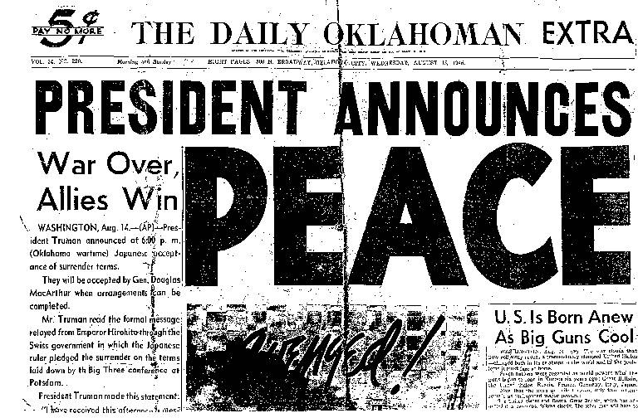
Backgrounds
Avoid distracting backgrounds with graphics.
NEVER use backgrounds with ‘ghost’ text.
Avoid multi-colored backgrounds: poor contrast.
Clear, unshaded backgrounds usually best.

Slide 21
Chemistry in the 21st Century
Analytical
Inorganic
Chemical
Engineering
Molecular
Biology
Bio
inorg
Materials
&
Nanosci
Physical
Organic
Organo-
met
Biochem
Bio
org
Phys
Org
Animation can be useful, but...

Slide 22
Chemistry in the 21st Century
Analytical
Inorganic
Chemical
Engineering
Molecular
Biology
Bio
inorg
Materials
&
Nanosci
Physical
Organic
Organo-
met
Biochem
Bio
org
Phys
Org
Animation can be useful, but DON’T get cute.

Slide 23

Slide Content

Slide 24
KIS: Keep It Simple!
A seminar is NOT a full research paper in a journal.
Your job is to convince and inform,
NOT to archive.
Present enough data to establish the point,
NOT all the data possibly available.
Simplify graphics whenever possible.

Slide 25
Type of Slides
Text Only: usually bulleted or numbered.
Graphs: x-y and bar strongly preferred.
Tables: almost always better as graph;
large tables (> 9 numbers) NEVER work.
Images: micrographs, ORTEPS, spectra, etc.
Conceptual
Cartoons: use judiciously, be credible, be careful!
Interrupters: explicit transitions between “chapters”;
(but remember, only one story).

Slide 26
Type of Graphs and Tables
ALWAYS label axes! ALWAYS show units!
Use Strong Colors. Avoid complex hatch markings.
Keep it Simple: 3-D graphs usually don’t work well.
Avoid novel graph forms.

Slide 27
Format of Graphs
100
ALWAYS use
thick lines (3 pt)
& strong colors.
90
East
(avoid “key”
boxes when
possible)
80
West
70
North
60
Y Title Bod (units)
50
North
West
East
40
30
20
10
TURN OFF autoscale. Fill slide well; use empty space cleverly.
0
0
{16 point}
2
3
4
5
X-axis Title (units) {20 point font}
Add a conclusions statement below: Give the Bottom Line.

Slide 28
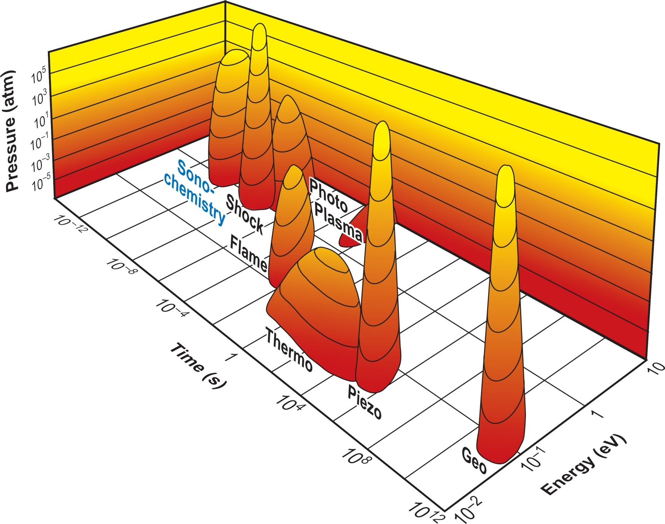
The Islands of Chemistry
(3 D plots can work,
if done well.)

Slide 29
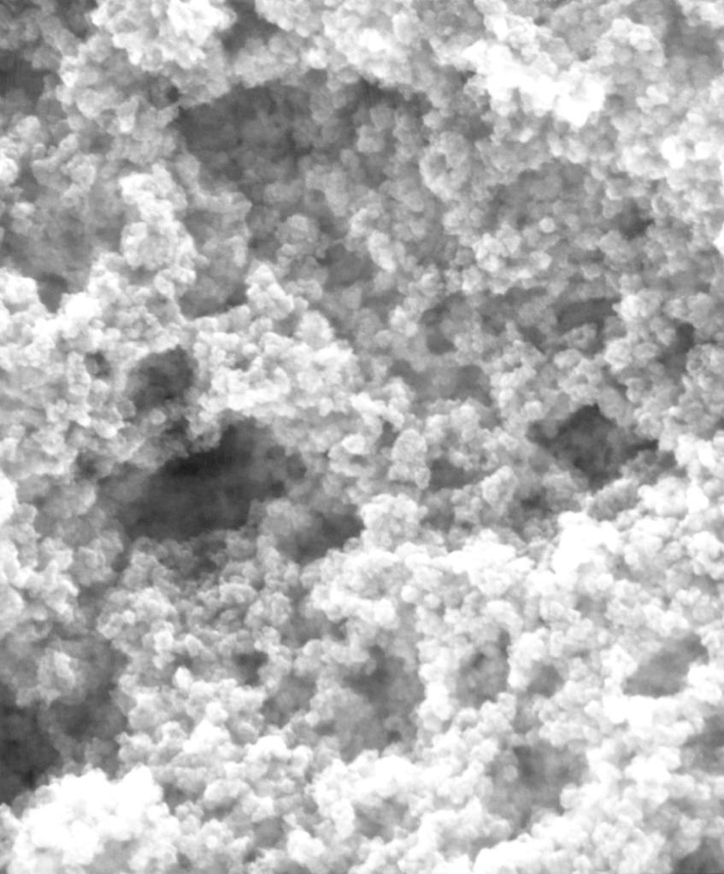
Micrographs Can Project Well
Give information with image.
ALWAYS provide size scale.
Use medium quality jpeg or png
(not tiff) at <200 dpi
(unless copying from a very small original).
Too high resolution images
will slow slide changing!
100 nm
Amorphous Fe
Sonicated Fe(CO)₅ under Ar,
25ºC, 20 KHz, 80 W

Slide 30
Spectra & Raw Data
Spectra or raw data can provide credibility.
Spectra must be well labeled (units!).
Label important assignments. Highlight with color.
Provide chemical structure with spectrum.
Data vs. computer models.
Designate data (e.g., x-ray structures) vs. simulation.
Don’t overdo it.
Too many spectra will obscure the big issues.

Slide 31
Jargon & Abbreviations
Avoid jargon – you’ll lose your audience.
Use rational abbreviations, sparingly.
Watch out for TLA’s
and FOLA’s
If there are lots of abbreviations,
use a separate slide for them.
Consider using a second projector (or overhead)
or even a separate handout.
(three letter abbreviations)
(four letter acronyms)

Slide 32
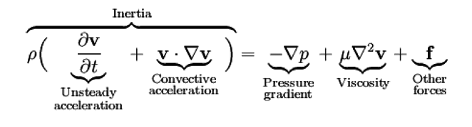
Equations
Keep them simple.
Your goal is to convince, not ‘prove’.
Proofs belong in written work, not in presentations.
Only show the important equations, limit details.
Always keep in mind your audience’s ignorance!
Define all symbols. Label parts of equations:
Make the equations big enough to be legible.
Navier-Stokes:

Slide 33
References
If you use someone else’s data or figure,
you MUST provide the citation.*
Give lead references, especially if they are yours.
Don’t cluster references on a single slide.
Only one or two per slide when relevant --
gives time to copy.
*14 point or 16 point at the bottom of the slide is OK. Smith et al., Nature, 2014, 133, 1451.

Slide 34
Humor
Be very, very careful.
Many scientists are badly humor impaired.
(A defect not covered by the Americans with Disabilities Act.)
Visual humor often best,
especially for an international audience.
Rank has its privileges:
The more senior you are,
the more you can get away with.
(i.e., the boss’s jokes always get more laughs.)

Slide 35
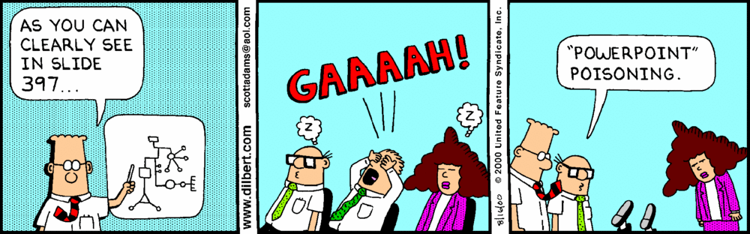
Humor
Make sure it’s appropriate for the occasion.

Slide 36

The Presentation

Slide 37
Practice Talks
“Be prepared.” It’s hard to practice too much.
Your goal is to communicate naturally.
Stream of consciousness doesn’t work.
Written script doesn’t work, either – too boring.
Get some friends to hear the talk
(AFTER you’ve already practiced a bit).
Listen to their feedback. Don’t be defensive:
if they’re confused, your real audience will be too.
Listen for “um”, “OK”, “ya know”, rising inflections,
and other distracting habits.

Slide 38
How Long?
Practice talks are always s l o w e r
than real presentations: adrenaline rush!
At meetings, KEEP to the schedule!
But also take the time you were allotted.
Don’t worry if your audience starts leaving —
worry when they start coming at you!

Slide 39
The Room
Know your room in advance.
Figure out the best lighting BEFORE the talk!
Think about where to stand.
Don’t block screen.
Be in the open, away from podium.

Slide 40
Hardware and Backup
Use your own computer, if at all possible!
NEVER change from PC to Mac or vice versa.
ALWAYS, ALWAYS have your talk backed-up
on a USB memory stick. Both pptx and pdf files.
With a tablet (or overheads):
Point at the projection screen, NOT at the tablet!
Audiences look where you look.
Turn off your own cell phone!!

Slide 41
Pointers for Pointers
Bring your own laser pointer.
Green is great. Red ok if 640 nm, NOT 670 nm.
DON’T keep the laser on all the time.
Push the button only sparingly!
The shakes: use two hands if needed.
Always carry an extra set of batteries.
Tygon tube to prevent shorts.

Slide 42
Some PowerPoint Shortcuts
F5 starts from slide #1.
SHIFT+F5 starts from current slide.
b blank / unblank screen.
slide #, ENTER goes to that slide (during presentation).
ALT+↑ Louder. ALT+↓ Quieter. ALT+U Mute.
Turn on “Use Presenter View” in “Slide Show”.
(shows a clock and slide miniatures on your screen)

Slide 43
Presenting: Voice
Slow down!
Be loud enough to be heard, even in the back.
(may seem to your ears to be TOO LOUD!)
Modulate the voice:
Don’t drone in MONOTONE.
Intentionally use a soft voice for emphasis
every once and a while.
Speak towards audience, not towards screen!

Slide 44
Presenting: Body, Hands, Eyes
Three modes of presenting:
(1) Slide focused. Use pointer to direct attention.
Don’t hide behind the podium.
(2) Group focused. Be sure to face audience.
Hand gestures: go bold or not at all.
Make eye contact with each audience member
(one at a time) frequently.
(3) Individual focused. Especially for Q & A.
Approach the questioner, hand gestures smaller.
It’s still for the audience, so make sure they can
hear you and the question (repeat Q if needed).

Slide 45
Attitude
Relax and be modestly confident. Remember:
You know more than they do about your talk.
Don’t be defensive.
Don’t be condescending.
Don’t try to impress, try to INFORM.
An informed audience will BE impressed.
Audiences can smell bullshit.
Don’t share your anxiety – it’s contagious!
Do show enthusiasm – it’s contagious!

Slide 46
Coming to Conclusions: Knowledge
“Knowledge is the small part of ignorance
that we arrange and classify.” — Ambrose Bierce
Knowledge is not memorization of facts,
it is the organization of the facts.
Knowledge is not the data,
it is the structure that connects the data.
The conclusions slide should present knowledge.

Slide 47
Conclusions & Acknowledgments Slides
Verbal comprehension is limited:
The Conclusions Slide should
tell them what you told them.
Present only the take-home messages:
i.e., what they should remember in 1 month.
Keywords, NOT long sentences.
Acknowledgments (note spelling): keep them brief.

Slide 48
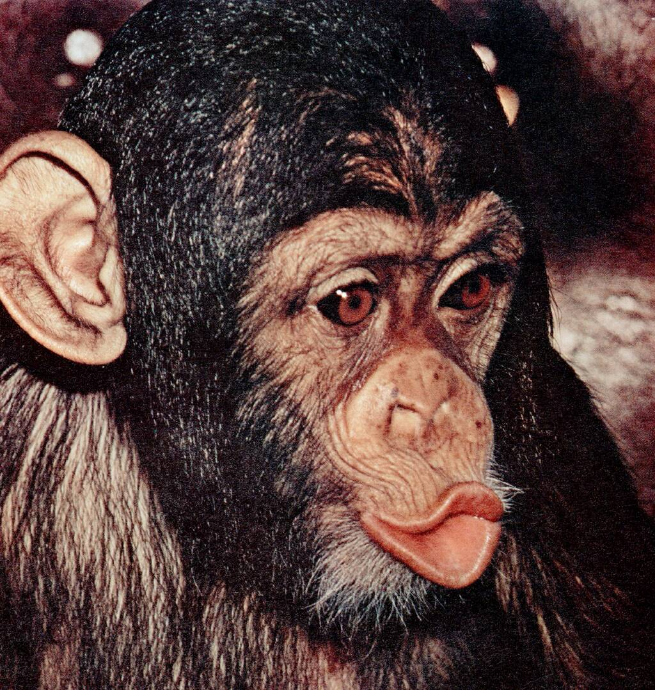
Q and A: Managing Ignorance
Don’t be defensive!
Make your answers as short and to the point as you can.
If you don’t understand a question, ask for rephrasing.
“I was gratified to be able
to answer promptly.
I said I didn't know.”
– Mark Twain

Slide 49
Ending
Let the audience know when you are done!
Give your closing line, and then
shut up and wait for the applause!
Best closing line:
“And finally, I’d like
to thank you for your
very kind attention.”

Slide 51
Zoom
All of this seminar still applies to remote presenting.
Check your equipment in advance!
Front light your face.
Put camera at face level (hard with some laptops).
Make your background uncluttered.
Do NOT use bluescreen virtual backgrounds!
Clichéd already. Don’t get cute.
Keep it live with “virtual eye-contact”:
Be sure to look directly into your camera!
Wear full clothing—you’ll feel more professional.

Slide 52
Zoom, Zoom!
Zoom lets you turn your face video on or off
while sharing your slides.
A “talking head” takes up valuable screen space.
Use it sparingly, at beginning and for Q&A.
Content is king, slides should dominate.
Use Zoom’s Chat function for questions,
but don’t get distracted during talk.
If you can, feel free to interact with audience
during your talk, especially for a pressing question.

Slide 53
Zoom vs. Zang: Pre-recorded Talks
Having apparent interaction with your remote
audience is critically important.
“Virtual eye-contact”: look directly into camera!
Mixed issues with continuous face videos.
Use video of you during intro then turn-off.
Take mini-breaks at transition points.
Use head video to speak directly to the viewer:
“Hi there! Remember me? Weird times isn’t it?...”
And then back to the slides. Content is king.

Slide 54
Zoom, Zang, Zunk: Prerecorded Slide Show
PowerPoint “Slide Show” menu allows recording
of narration of slides (with or w/o video),
but loses anything said between slides.
Use animation of text to avoid overwhelming viewer.
Slide Show lets you record use of a “laser pointer”.
  To show and move laser pointer:
  ctrl key + left mouse button while dragging mouse.
  This lets your audience keep up with you.
Slide Show also allows recording a video inset,
together with your narration. The inset is small,
but can be resized after the recording.

