Slide 1
History of Chemistry Workshop: Inorganic Chemistry
• What is “Inorganic Chemistry”?
- descriptor or professional subfield
- same as “General Chemistry”?
• Highlights from the inorganic timeline
- Lavoisier: origin of modern chemistry
( Frankland: introduction of organometallics)
- Mendeleev: periodic table
- Werner: elucidation of coordination chemistry
- Wilkinson: introduction of organometallics
- Basolo: mechanism in inorganic chemistry
• Recent (and future?) directions

Slide 2
Rise of specialization
• “Chemistry” was an undifferentiated field until well into the 1800s
• First usage of terms “inorganic” and “organic” ca. 1775 (?)
- distinguish origin of substances: mineral vs. animal/vegetable
- attributed to Swedish chemist Torbern Bergmann
• Wöhler’s famous experiment disproving vitalism (1828)
- urea would generally not be considered organic in current terminology
• First usage of terms “organic chemistry” and “inorganic chemistry” in the 1830s
- which one would dominate?

Slide 3
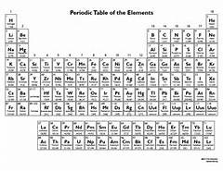
Inorganic vs. organic: 117 to 1?

Slide 4
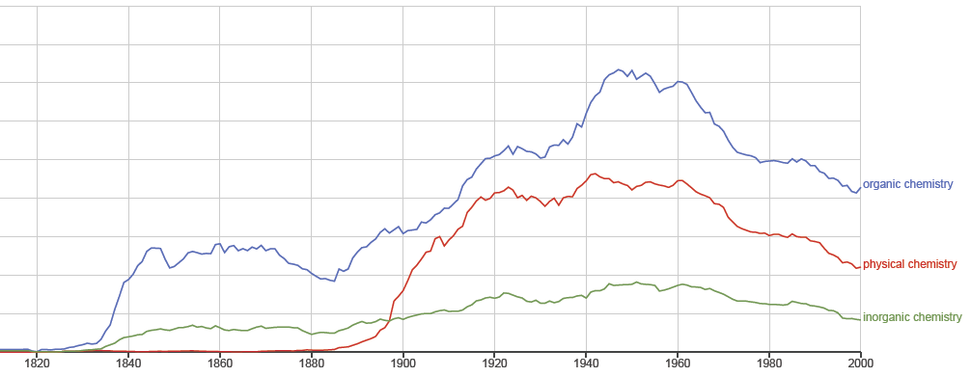
Frequency of appearance of phrases in books in English, 1800-2000. Generated using Google Books Ngram Viewer

Slide 5
• Major 19th C developments in chemical understanding came from
studies of organic compounds
• Organic chemistry dominated the field for the last half of the century
• Physical chemistry established as a recognized subfield around 1890
• Why has inorganic been so relatively under-respected??

Slide 6
“Between 1870 and 1890 the rapid development of organic chemistry gave it such a
relative prominence that the other branches of the science rather suffered in
consequence. Inorganic chemistry particularly seemed to be drifting towards the
discouraging position of a completed science, and some predicted for it little further
growth.”
F. J. Moore, A history of chemistry, 1918
“While the great development of organic chemistry was taking place, a smaller number
of chemists continued to devote themselves to the older discipline of inorganic chemistry
….As a result of all these factors the foundation for great progress in general chemistry
were laid down during the nineteenth century.”
H. M. Leicester, The historical background of chemistry, 1956
“Organic chemistry developed a program of study, a language of discourse, and a system
of explanation that was foreign to the practitioners of an earlier general chemistry.”
M. J. Nye, Before big science, 1996
“Inorganic chemistry is a subject that exists by default — it is the part of chemistry
that remained when organic chemistry (the chemistry of carbon compounds containing
at least some carbon-hydrogen bonds) and physical chemistry (the science of physical
measurements as applied to chemical systems) developed as distinct subdisciplines in
the nineteenth century.”
T.W. Swaddle, Inorganic chemistry : an industrial and environmental perspective, 1997

Slide 7
Inorganic or general chemistry?
• What topics belong to inorganic as opposed to chemistry in general?
- discovery of the elements
- periodic classification of elements
- consistent atomic weights
• Is inorganic chemistry just the dregs??
• Is an inorganic chemist merely someone who isn’t an organic chemist??
“Chaplain, I once studied Latin. I think it’s only fair to warn you of that before I ask
my next question. Doesn’t the word Anabaptist simply mean that you’re not a Baptist?”
“Oh, no, sir. There’s much more.”
“Are you a Baptist?”
“No, sir.”
“Then you are not a Baptist, aren’t you?….Now, Chaplain, to say you’re not a Baptist doesn’t
really tell us anything about what you are, does it? You could be anything or anyone.”
Joseph Heller, Catch-22

Slide 8
Inorganic or general chemistry?
• First journal devoted to inorganic chemistry, Zeitschrift für Anorganische Chemie,
was established in 1892
  - changed to Zeitschrift für Anorganische und Allgemeine Chemie, 1915
- changed back to Zeitschrift für Anorganische Chemie, 1943
- changed back again to Zeitschrift für Anorganische und Allgemeine Chemie, 1950
• No English-language inorganic journal until 1955 (Journal of Inorganic and Nuclear Chemistry)
• ACS journal Inorganic Chemistry began in 1962

Slide 9
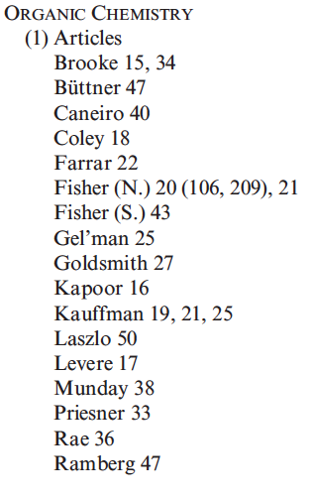
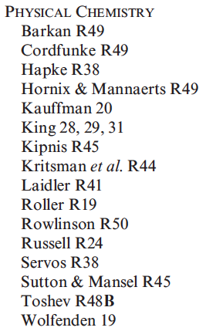
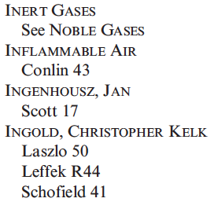
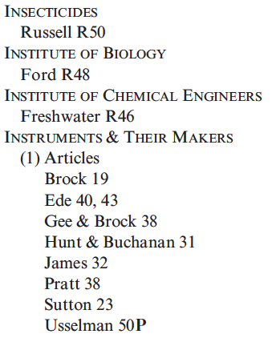
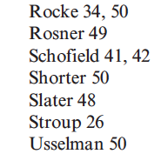
Disinterest persists among historians of chemistry….
From the index to Ambix, the journal of the Society for
the History of Alchemy and Chemistry, 1937-2003

Slide 10
Interest among chemists arguably took off around the middle of the 20th century
Share of presentations at ACS National Meetings in Organic (w), Physical (n),
and Inorganic (s) Divisions, 1925-2012 (trend lines are 10-year moving averages)

Slide 11
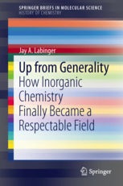
For more detail…..

Slide 12
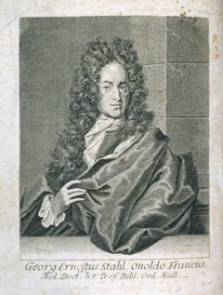
Lavoisier and the “chemical revolution”
• Phlogiston as prevailing explanatory system for most of 18th century
- Stahl, 1718
Georg Ernst Stahl (1659-1734)

Slide 13
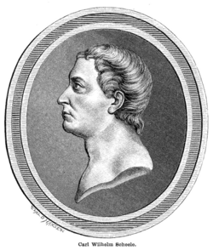
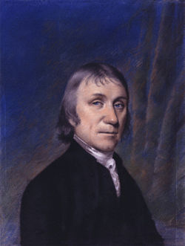
Lavoisier and the “chemical revolution”
• Oxygen as fundamental principle
Carl Wilhelm Scheele (1742-1786)
Joseph Priestley (1733-1804)
Further reading: Oxygen, a play by Carl Djerassi and Roald Hoffmann

Slide 14

Lavoisier and the “chemical revolution”
For Lavoisier restructured chemistry from fundamental principles [and] provided it
with a new language and fresh goals. . . . A modern chemist, on looking at a chemical
treatise published before Lavoisier’s time, would find it incomprehensible; but
everything written by Lavoisier himself, or composed a few years after his death,
would cause a modern reader little difficulty.
Brock
Antoine Lavoisier (1743-1794)

Slide 15
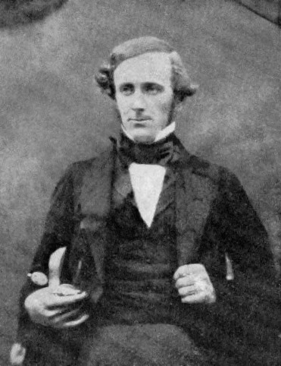
Frankland and organometallic chemistry
Frankland, 1852
(Note: these are modern representations;
atomic weights and hence formulae
were still uncertain at that time)
Edward Frankland (1825-1899)

Slide 16
Frankland and organometallic chemistry
• Findings played key role in Frankland’s formulation of the concept of combining capacity
- valence
• Concept used mainly in organic, not inorganic chemistry — why?
- multiple combining formulae for many elements confused matters?
- inorganic chemistry wasn’t respectable enough to attract conceptual thought?
• Organometallic chemistry of the main-group metals (essentially all there was then)
remained the virtually exclusive province of organic chemistry, through and beyond the
important development of organomagnesium chemistry (Barbier/Grignard, 1899)
- we will come back to organo-transition metal chemistry

Slide 17
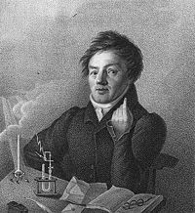
Mendeleev and the periodic table
• Attempts at systematic classification of elements go back to early 19th century
- “Triads”: groups of 3 chemically similar elements whose atomic weights formed
regular patterns: middle one close to average of other two
Ca 27.5, Sr 50, Ba 72.5 Cl 35.5, Br 78.4, I 126.5
(Döbereiner, 1816)
Johann Wolfgang Döbereiner (1780-1849)

Slide 18
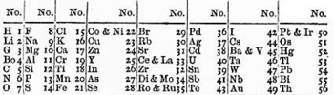
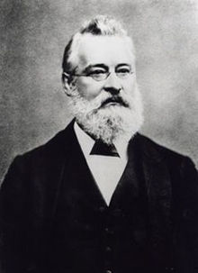
Mendeleev and the periodic table
• Attempts at systematic classification of elements go back to early 19th century
- “Octaves”: arranging elements in order of increasing atomic weight gave pattern
of repeating similar chemical behavior every 8th element
(Newlands, 1866)
John Newlands (1837-1898)

Slide 19
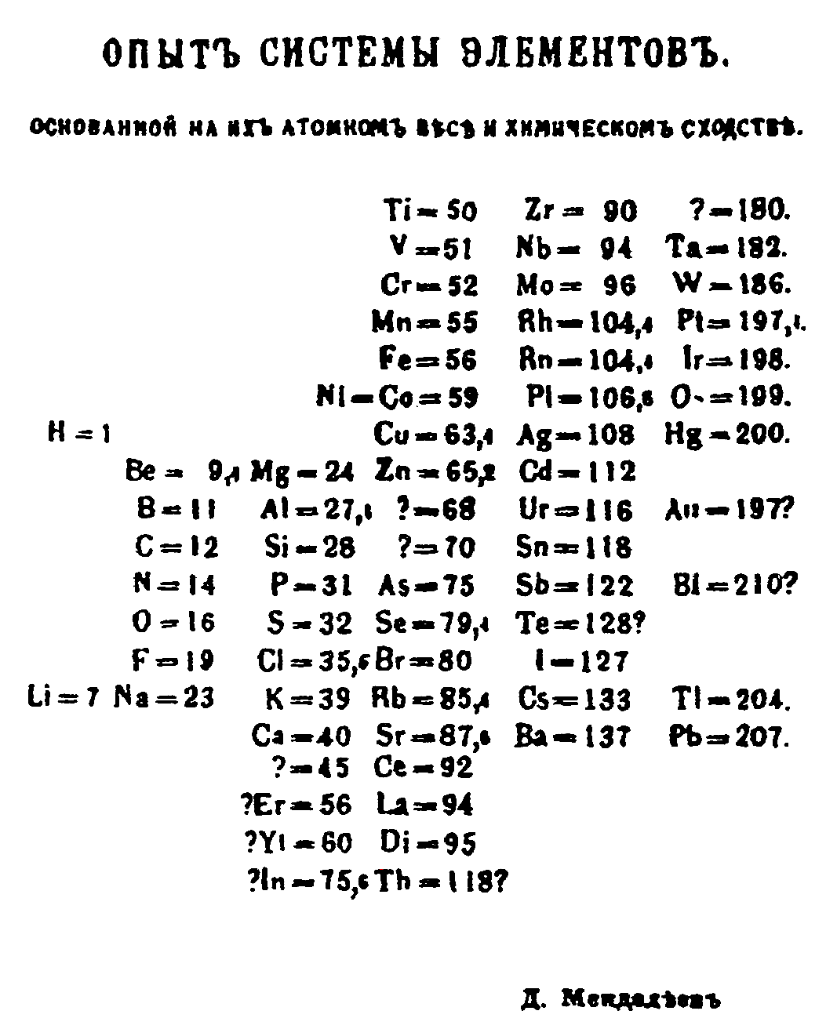
Mendeleev and the periodic table
• Mendeleev: obtained a table with extensive repeating (“periodic”) properties from
such an arrangement (1869)
- enabled prediction of “missing” elements as well as hitherto unknown atomic weights
- similar work done independently by Lothar Meyer

Slide 20
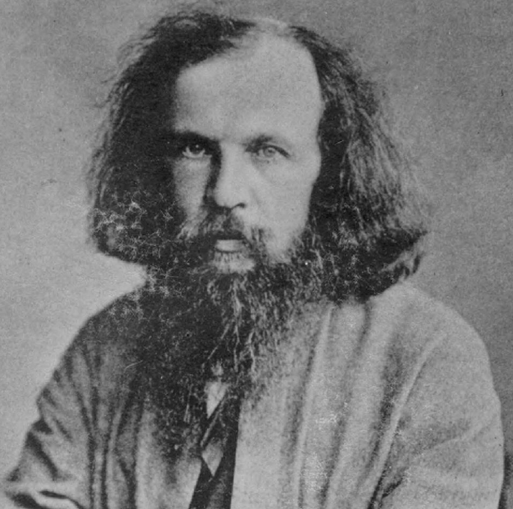
Did Mendeleev revolutionize inorganic chemistry?
“It [the Periodic Table] also provided for inorganic chemistry its first great generalization….But it is all too easy to overstate its importance for suggesting lines of research….Indeed, it is not going too far to say that the most important discoveries in inorganic chemistry for the rest of the century not only owed little to the Periodic Table but actually offered it an embarrassing challenge.”
C. A. Russell, The structure of chemistry, 1976
Dimitri Mendeleev (1834-1907)
Mendeleev’s title at the University of St. Petersburg:
“Professor of General (Inorganic) Chemistry”

Slide 21
Werner and coordination chemistry
• “Embarrassing challenge” no doubt included “complex” species where valence
(an important component of the chemical relationships that led to recognizing
periodic behavior) seemed indeterminate.
• Cobalt-ammonia-chloride system: Co(NH₃)_{x}Cl₃ where x = 3, 4, 5 and 6
- different colors; different numbers of precipitable Cl; multiple “isomers” of some
- for “simple” cobalt compounds valence of 3 was thought to be common
- what is it here — 6, 7, 8, 9? How could they all exist? What could the structures be?
• Jorgenson model:

Slide 22
Werner and coordination chemistry
• Werner interpretation (1893): “inner-sphere” and “outer-sphere” interactions
[Co(NH₃)₃Cl₃], [Co(NH₃)₄Cl₂]⁺Cl⁻, [Co(NH₃)₅Cl]²⁺(Cl⁻)₂, [Co(NH₃)₆]³⁺(Cl⁻)₃
• Valence = 3: number of Cl’s (anionic)
• “Coordination number” = 6: inner-sphere bonds
• Octahedral arrangement of 6 “ligands” (term introduced by Stock in 1916) can
account for isomerism

Slide 23
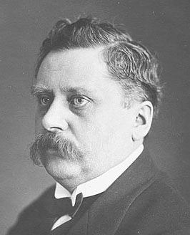
Did Werner revolutionize inorganic chemistry?
“It was simply not true that coordination complexes played a key role in inorganic
chemistry either then [just before the First World War] or for 40 years ahead.
What Werner did do in his own fairly short lifetime was to convince people that
in this area…his theory was a satisfactory explanation.”
C. A. Russell, The structure of chemistry, 1976
Pre-1973 Nobel Prizes for inorganic (?) chemistry:
1906: Moissan (F₂ and electric furnace)
1911: Curie (Ra, Po)
1914: Richards (accurate atomic weights)
1935: Joliot/Joliot-Curie (radioelements)
1951: McMillan/Seaborg (radioelements)
Alfred Werner (1866-1919)
Nobel Prize 1913

Slide 24
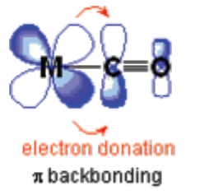
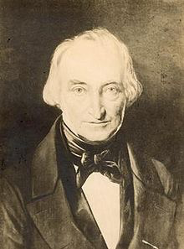

Wilkinson and organo-transition metal chemistry
• Organo-transition metal chemistry relatively uncommon before mid-20th century
• Zeise’s salt: K[Pt(C₂H₄)Cl₃]
- obtained accidentally from Pt chlorides and ethanol by Danish pharmacist in 1827
- nature of bonding not understood at all
• Metal carbonyls
- Ni(CO)₄ prepared by Mond in 1890; many followed
- Hieber’s systematic studies in 1930s-40s
- strong bonding of CO to a metal center seemed at odds with understanding of
coordination chemistry
• Explanations in terms of MO bonding model developed around 1950
- partially filled d orbitals of transition metals interact with vacant π* orbitals of
unsaturated ligands such as ethylene, CO
William Zeise (1789-1847)
Walter Hieber (1895-1976)

Slide 25
Wilkinson and organo-transition metal chemistry
• Transition metal alkyls virtually unknown
- Wide range of main group alkyls readily obtained by transmetallation reactions,
such as MX_{n} + n RMgX
- Similar treatment of transition metal MX_{n} almost always led to decomposition,
generation of organics derived from R•
• Attempt to make fulvalene gave instead a remarkably stable species (C₅H₅)₂Fe
(Pauson, 1951)
• Wilkinson (then at Harvard) and R. B. Woodward correctly interpreted as π−bonded
“sandwich” structure, which they called ferrocene

Slide 26
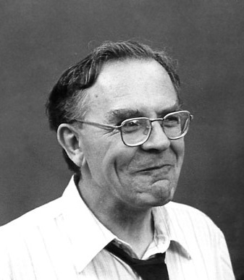
Wilkinson and organo-transition metal chemistry
• Transition metal organometallic chemistry grew tremendously over next decades
- many more examples of complexes with π−bonded ligands
- understanding bonding principles led to synthesis of stable alkyls and related species
- wide variety of homogeneous catalytic reactions and organic synthetic
transformations mediated by organo-transition metal complexes
• Most of developmental work carried out by (self-described) inorganic chemists
- organic chemists gradually moved into field as power became recognized
Further Nobel Prizes for organo-TM chemistry:
2001: Knowles, Noyori, Sharpless (catalysis)
2005: Chauvin, Grubbs, Schrock (olefin metathesis)
2010: Heck, Negishi, Suzuki (cross-coupling)
Geoffrey Wilkinson (1921-1996)
Nobel Prize 1973
(shared with E. O. Fischer)

Slide 27
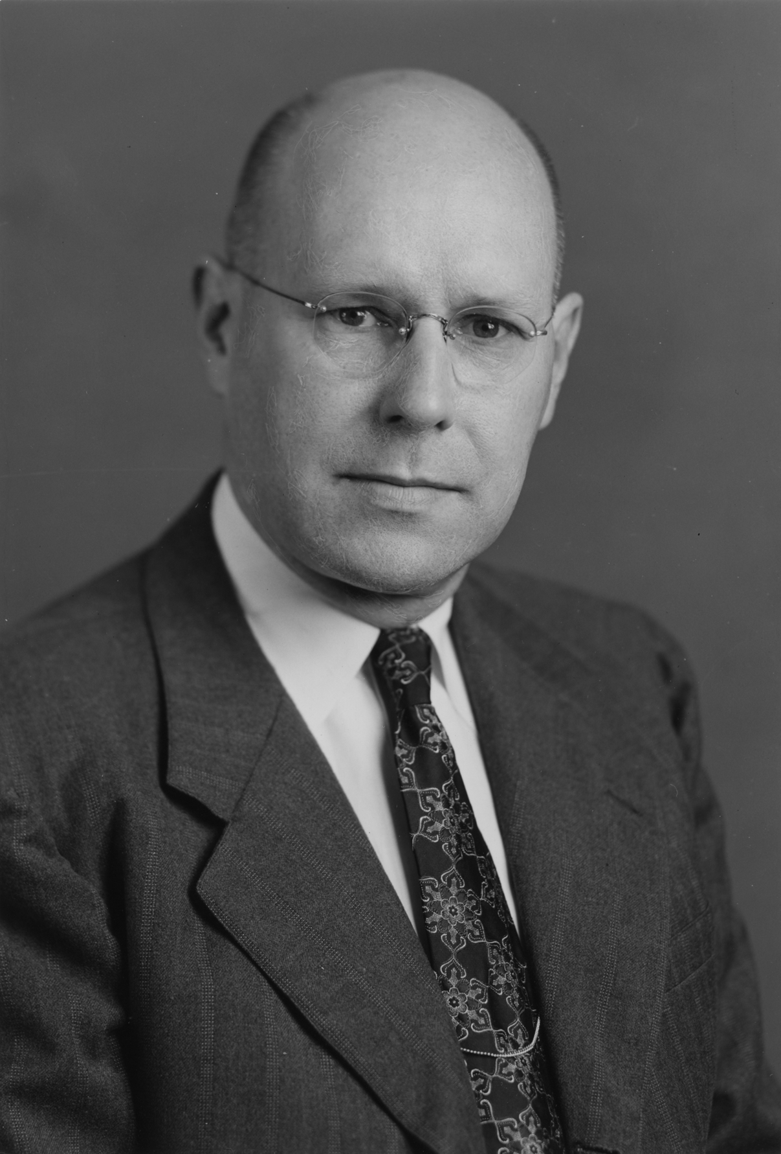
Mechanism in inorganic chemistry
• Organic chemists significantly increased focus on mechanism in the 1920s-1930s
(“Physical organic chemistry”)
• Little or no such efforts in inorganic chemistry during period
- field accordingly viewed by many as intellectually less interesting than organic or
physical
• Bailar possibly first inorganic chemist to recognize opportunities:
“In 1893 Paul Walden [1863-1957] discovered the very interesting inversion reaction
which bears his name. It was an extremely important discovery, for it called attention
to the chemists of that day that reactions have mechanisms. It occurred to me that if we
repeated Werner's experiment….we might also get an inversion....if we could get an
inversion with an octahedral model rather than a tetrahedral one, we might be able to
rule out some of the theories which had been advanced for the inversion in reactions of
the tetrahedral organic molecules.”
John Bailar (1904-1991)

Slide 28
Mechanism in inorganic chemistry
• Bailar’s PhD student Fred Basolo, along with his Northwestern colleague Ralph Pearson,
led the movement, especially with their 1958 book “Mechanisms of Inorganic Reactions”
“[During WWII] I was primarily interested in seeing what was being published by inorganic
chemists in the U.S. Precious little was being published, and what was reported was of only
marginal interest to me….I found that some articles on physical organic chemistry caught my
attention. These described research on the kinetics and mechanisms of solvolysis reactions….
The more I read such papers, the more certain I felt that inorganic chemists could investigate,
in a similar manner, some of the ligand substitution reactions of octahedral and square planar
metal complexes.
“Ralph [Pearson] knew a great deal about the kinetics and mechanisms of organic reactions….
Each time I brought up the subject of our collaboration on the kinetics and mechanisms of
metal complexes, Ralph’s response was ‘why should I work on inorganic chemistry, which is
of little or no interest.’ However, I was finally able to convince him….”

Slide 29
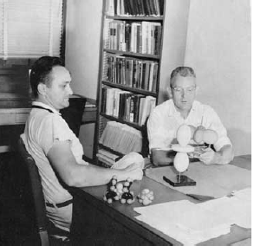
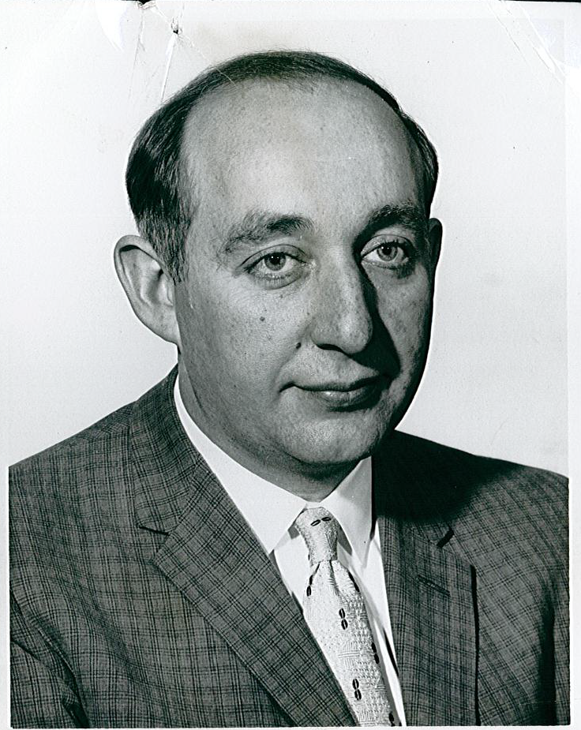
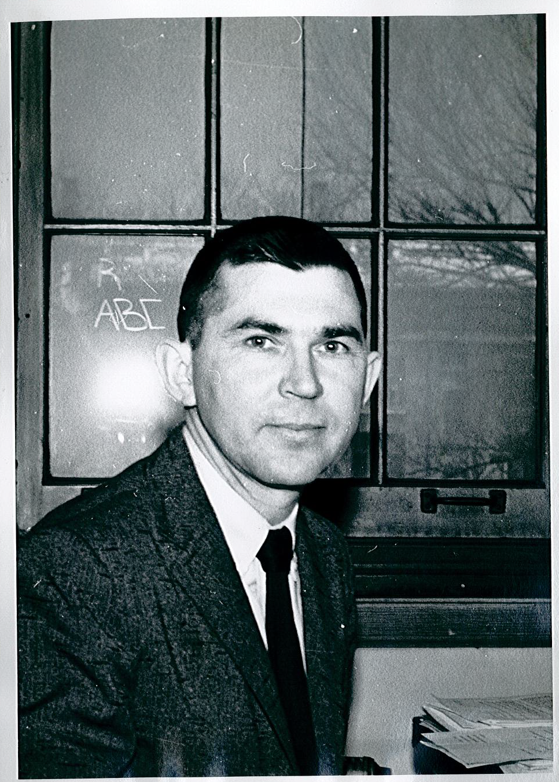
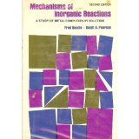
Mechanism in inorganic chemistry
• Other contemporary researchers also stimulated interest in field
Fred Basolo & Ralph Pearson
(1920-2007) (1919- )
Jack Halpern
(1925- )
Henry Taube
(1915-2005)
Nobel Prize 1983
Further Nobel Prizes for inorganic chemistry:
1976: Lipscomb (boron compounds)

Slide 30
Where has the field gone in the last half-century? Where is it going?
• Major new subfields evolved….
- catalysis and energy applications
- spectroscopic and related methodology
- bioinorganic chemistry
- solid state chemistry (materials science)
- nanotechnology
….while older ones continue….
• Subdivisions of ACS INOR Division:
- organometallic chemistry (1967)
- solid state chemistry (1972)
- bioinorganic chemistry (1985)
- nanoscience (2003)
- coordination chemistry (2012)
….but despite apparent centrifugal forces, internal cohesion (loyalty?)
remains strong

Slide 31
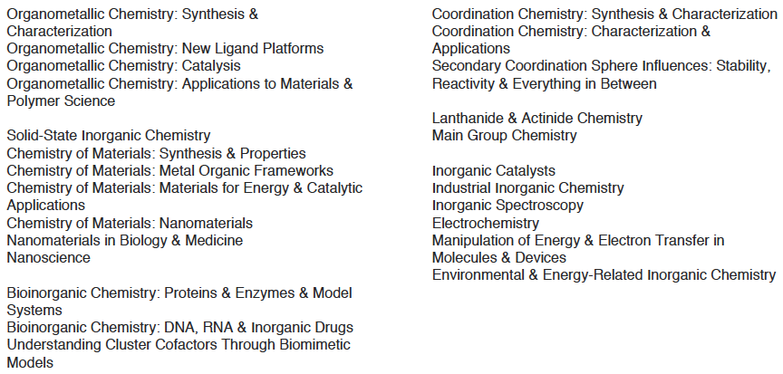
Where has the field gone in the last half-century? Where is it going?
• Session titles at upcoming ACS national meeting:

