Slide 1
Failures of the Feynman propagators
So Hirata
Department of Chemistry, University of Illinois at Urbana-Champaign
Ireneusz Grabowski
Institute of Physics, Nicolaus Copernicus University in Toruń
J. Vincent Ortiz
Department of Chemistry & Biochemistry, Auburn University
Rodney J. Bartlett
Quantum Theory Project, University of Florida

Slide 2
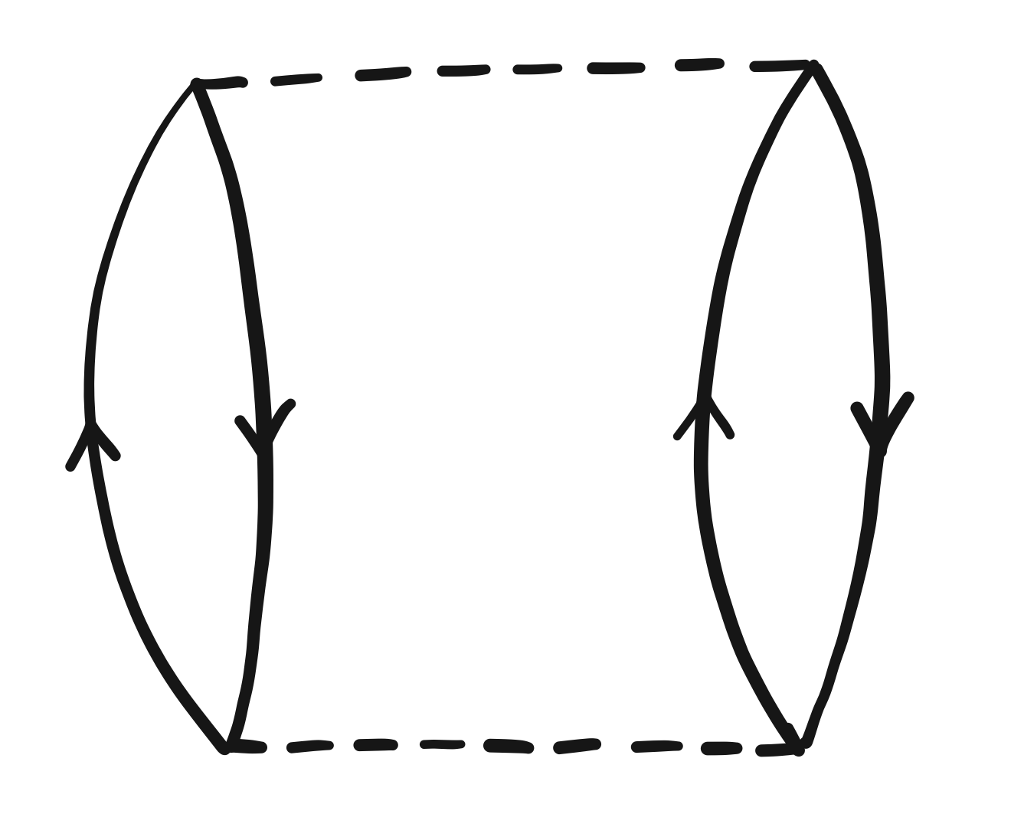
Feynman propagator in physics
[Feynman] had his own private way of doing [perturbation] calculations, based on things that he called “propagators.” These were probability amplitudes for particles to propagate from one space-time point to another.
Feynman’s propagators were identical with Green’s functions.
They were once again the working tools of calculation, both in particle physics and in condensed matter physics.
F. Dyson, “George Green and physics”
Physics World (1993)
Richard Feynman
Telescopes
X-ray
Computers
Freeman Dyson

Slide 3

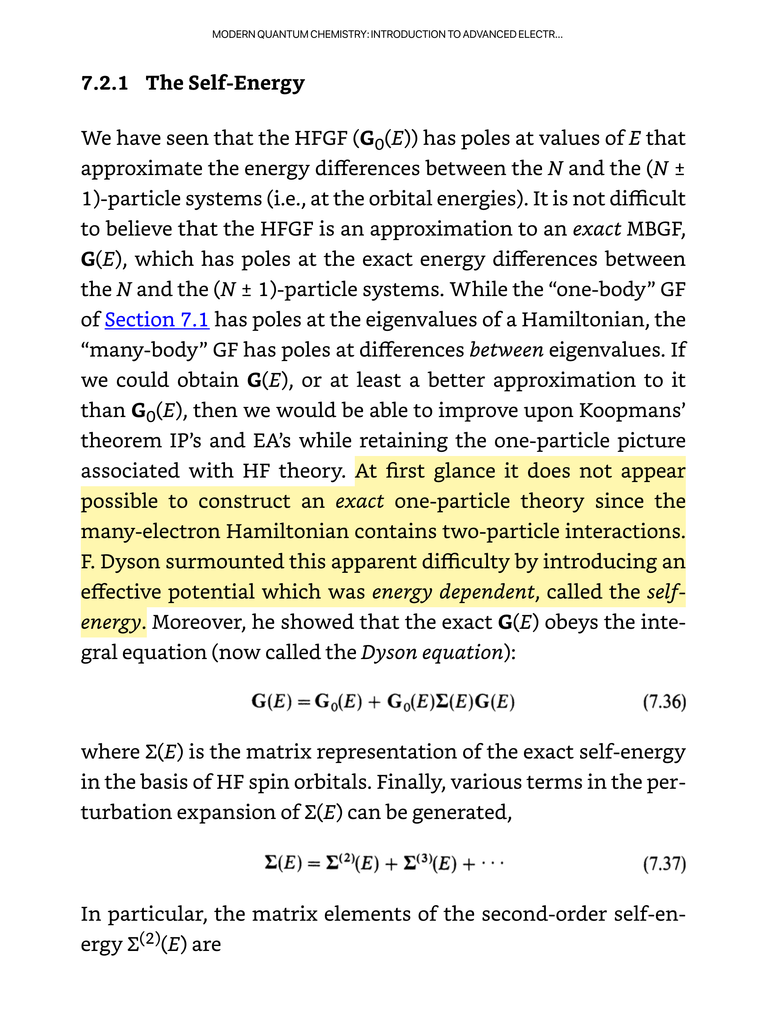
Feynman propagator in chemistry
Hartree–Fock theory
Exact one-particle theory

Slide 4
MBGF in 9 pages + 1

Slide 5
MBGF in 9 pages (1/9)
Exact N-electron
GS wfn
Green’s function
#MO x #MO matrix
IP sector
Hole propagator
Particle propagator
Exact N-electron GS energy
EA sector
Exact N–1-electron nth state wfn
Poles at exact IP
Poles at exact EA

Slide 6
MBGF in 9 pages (2/9)
Perturbation expansion
Møller–Plesset partitioning
HF N-electron GS wfn
HF N-electron GS energy

Slide 7
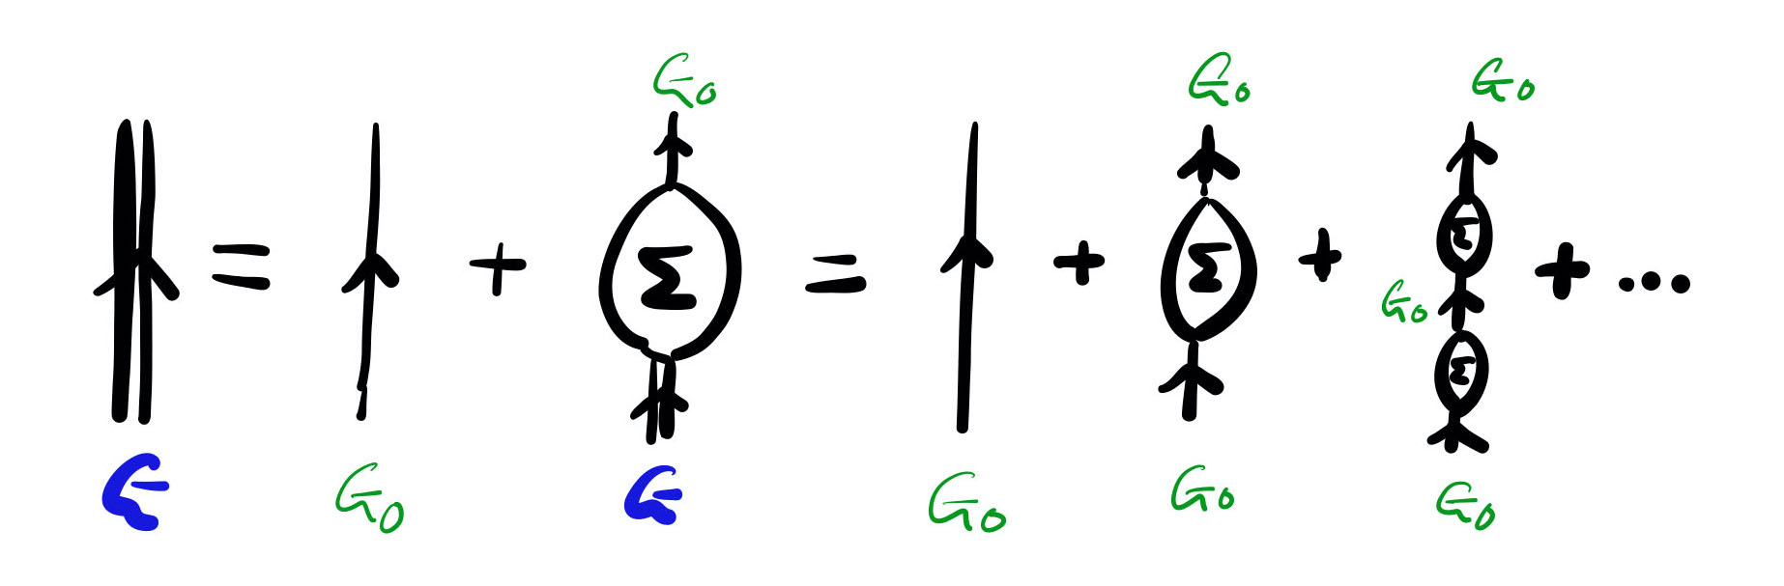
MBGF in 9 pages (3/9)
Dyson equations
Dyson equation defines the self-energy
Dyson equation in long form
Dyson equations in diagrammatic form

Slide 8
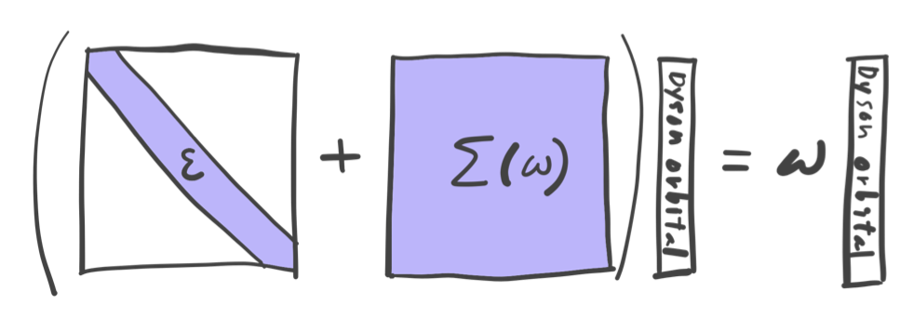
MBGF in 9 pages (4/9)
Inverse Dyson equation
Inverse Dyson equation
at exact IP/EA
Exact one-particle equation!

Slide 9
MBGF in 9 pages (5/9)
For each eigenvalue there are multiple roots

Slide 10
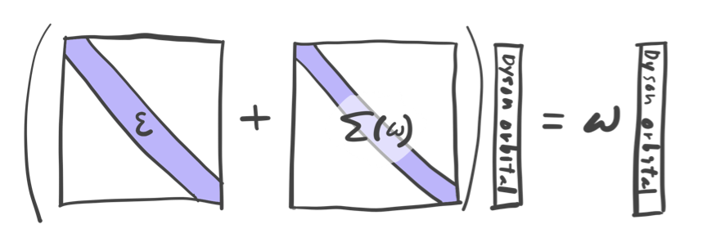
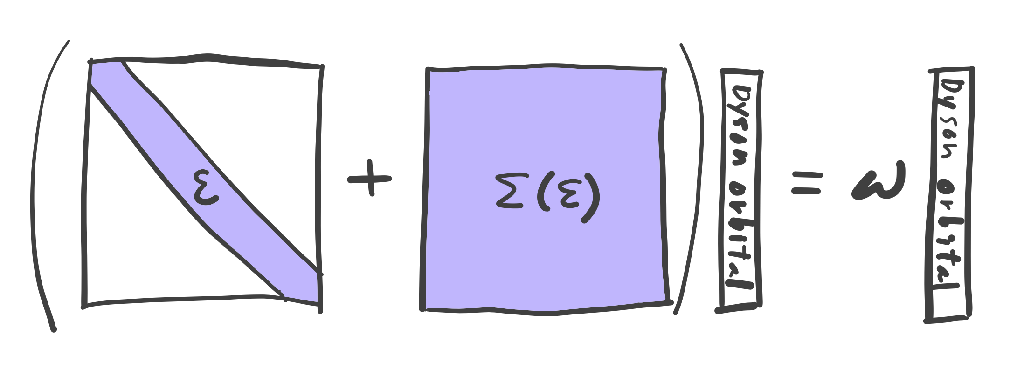
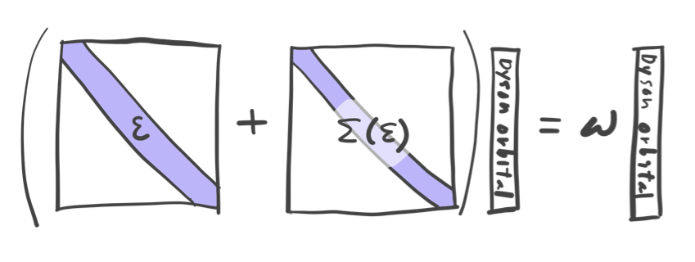
MBGF in 9 pages (6/9)
Approximations
Diagonal
ω-independent
Diagonal, ω-independent

Slide 11
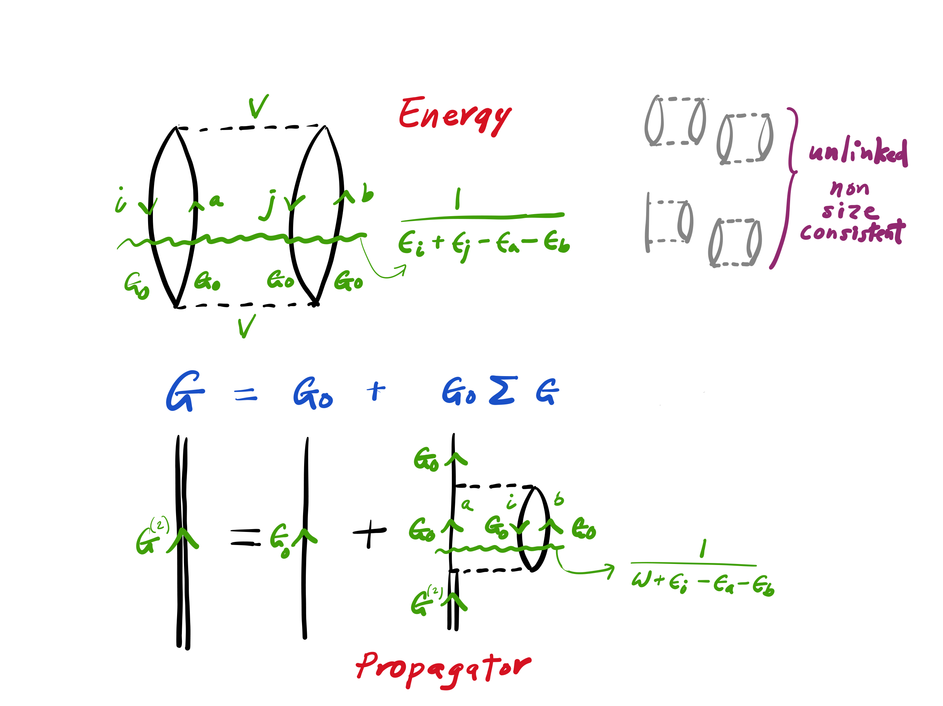
Diagrams 101

Slide 12
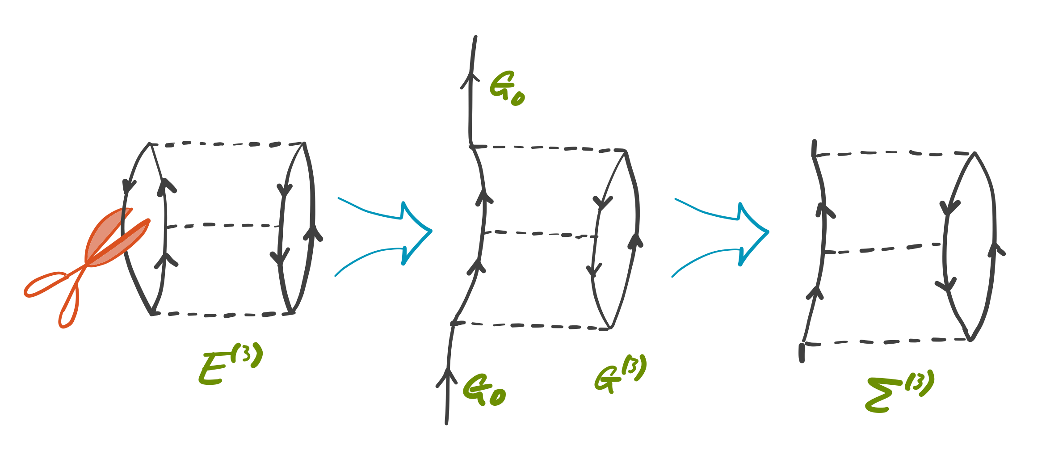
MBGF in 9 pages (7/9)
Diagrammatics: rule #1 (linked-only)
Cutting a line of a MBPT energy diagram and trimming the dangling lines (the resulting diagram is linked and size consistent)

Slide 13
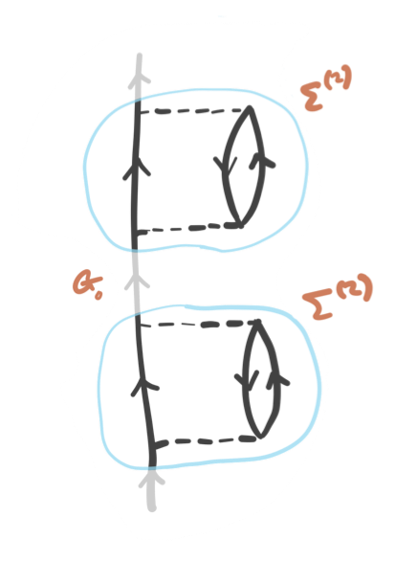
MBGF in 9 pages (8/9)
Diagrammatics: rule #2 (irreducible-only)
Exclusion of reducible diagrams (so that no over-counting)

Slide 14
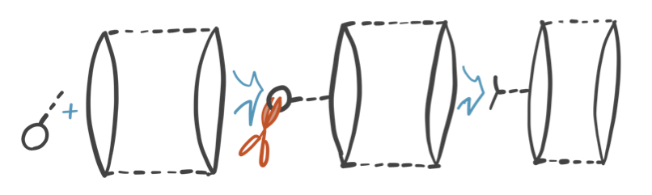
MBGF in 9 pages (9/9)
Diagrammatics: rule #3 (a bubble insertion)
A bubble (V) insertion (so that no under-counting)
or cutting open a bubble of non-HF MBPT energy diagrams (cf. Bartlett)
12 GF3 diagrams
Simons and Smith
J. Chem. Phys. (1973)
6 additional GF3 diagrams
Purvis and Öhrn
Chem. Phys. Lett. (1975)

Slide 15
General-order algorithms

Slide 16
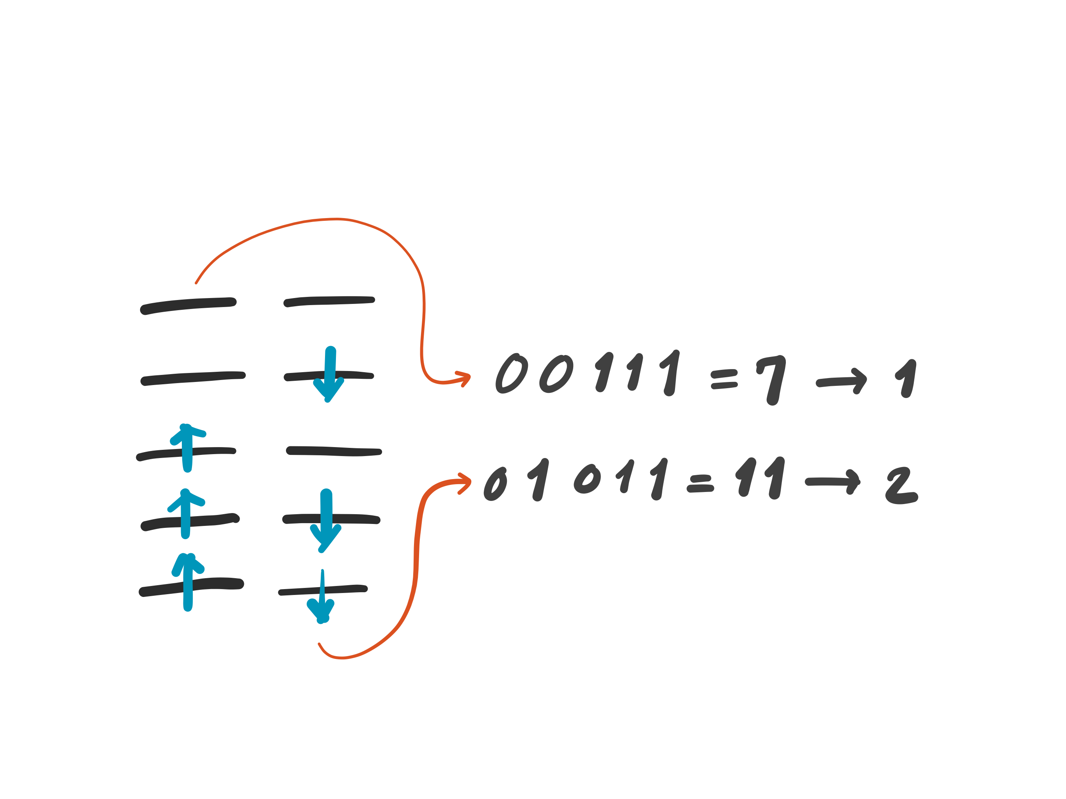
General-order CI
Determinant-based full configuration interaction
  Knowles and Handy, Chem. Phys. Lett. 1984.
String Address
Peter Knowles
Cardiff

Slide 17
General-order MP
Determinant-based, general-order Møller-Plesset perturbation (MP) theory
  Knowles, Somasundram, Handy,
  and Hirao, Chem. Phys. Lett. 1985.
Peter Knowles
Cardiff

Slide 18
General-order CC
Determinant-based, general-order coupled-cluster (CC) theory
  Hirata and Bartlett, Chem. Phys. Lett. 2000.
  Kállay and Surján, J. Chem. Phys. 2000.
  Olsen, J. Chem. Phys. 2000.

Slide 19
General-order EOM-CC
Determinant-based, general-order equation-of-motion coupled-cluster (EOM-CC) theory for excited, ionized, and electron-attached states
  Hirata, Nooijen, and Bartlett, Chem. Phys. Lett. 2000.
  Hirata, Nooijen, and Bartlett, Chem. Phys. Lett. 2000.

Slide 20
MBGF recursions & general-order algorithms

Slide 21
Backstory of general-order MP
FCI with modified H
Numerical differentiation
Peter Knowles
Cardiff
  Knowles, Somasundram, Handy and Hirao, Chem. Phys. Lett. 1985.

Slide 22
General-order MBGF #1: λ-variation
FCI with modified H
Numerical differentiation
Hirata, Doran, Knowles and Ortiz, J. Chem. Phys. (2017)

Slide 23

General-order MBGF #2: diagrams
λ-variation
Diagrams
Agreement
Agreement
Agreement
Agreement
Alex Doran
UIUC
Hirata, Doran, Knowles and Ortiz, J. Chem. Phys. (2017)

Slide 24
General-order MBGF #3: recursion 1
RI insertion of exact wave functions
Hirata, Doran, Knowles and Ortiz, J. Chem. Phys. (2017)

Slide 25
General-order MBGF #4: recursion 2
RI insertion of Slater determinants
Hirata, Doran, Knowles and Ortiz, J. Chem. Phys. (2017)

Slide 26
General-order MBGF #5: recursion 3
Biorthogonal RI insertion
ΔMPn
Hirata, Doran, Knowles and Ortiz, J. Chem. Phys. (2017)

Slide 27
Linked-diagram theorem
Unlinked diagrams mutually cancel exactly, justifying the diagrammatic rule #1 (linked-only) and size consistency.
Hirata, Doran, Knowles and Ortiz, J. Chem. Phys. (2017)
Frantz and Mills Factorization Theorem (1960)

Slide 28
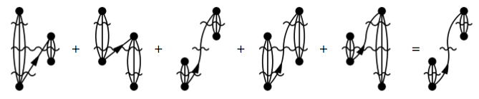
Irreducible-diagram theorem
Single G⁽⁰⁾ lines can be factored, justifying the trimming of dangling lines and diagrammatic rule #2 (irreducible only).
Hirata, Doran, Knowles and Ortiz, J. Chem. Phys. (2017)

Slide 29
Exact convergence of Koopmans IP
BH HOMO
r = 1.232 Å
the minimal basis
frozen core
Hirata, Doran, Knowles and Ortiz, J. Chem. Phys. (2017)

Slide 30
Failures of Feynman propagators

Slide 31
Exact Green’s function
It diverges at exact IPs and EAs
Full CI IPs
Full CI EAs

Slide 32
Exact self-energy
Its eigenvalues intersect the diagonal ω line at exact IPs and EAs
Full CI IPs
Full CI EAs

Slide 33
Perturbative self-energies
Next, the same diagonal element of the second-order self-energy is not bad
First, a diagonal element of the exact self-energy looks like ...
The third-order self-energy has a wrong shape and few intersections (roots)
The fifth-order self-energy again has a wrong shape and almost no roots
The fourth-order self-energy recovers the correct shape and roots

Slide 34
Perturbative Green’s functions
Through second-order Green’s function has poles
Through third-order Green’s function is missing many poles
Through fourth-order Green’s function again has poles
Through fifth-order Green’s function again loses poles

Slide 35
Even-order Σ^{(n)} are non-convergent
4
2
10
8
6
Exact

Slide 36
Infinite-order theories are worse!
Tamm–Dancoff approximation (TDA) renormalizes a vertex and sums over ladder and ring diagrams up to infinite order

Slide 37
Tamm–Dancoff approximation
After 20th cycle of iterative solution of the amplitude equation, TDA has included up to qualitatively wrong 21st-order self-energy
After 21st cycle, TDA has included up to qualitatively correct 22nd-order self-energy, but quantitatively very poor

Slide 38
Infinite-order theories are worse!
Self-consistent 2nd-order Green’s-function [sc(2)] renormalizes edges and sums over tower diagrams up to infinite order

Slide 39
Self-consistent Green’s function
As the self-consistent iteration progresses, the number of roots increases factorially, reaching an astronomical value in the second cycle
#poles = 72
#poles = 4314
Histograms of poles (heights are residues)
#poles = 600

Slide 40
What is the cause of nonconvergence?
Taylor expansion of the following model Green’s function in terms of λ is nonconvergent at many domains of ω for any E_{n}(λ)

Slide 41
Conclusion: nonanalytic physics
Superconductivity
Thermodynamics (Kohn–Luttinger problem)
Feynman propagator

Slide 42
Conclusion: practical implications
Feynman–Dyson diagrammatic perturbation theory is useless for many or most satellite (non-Koopmans) IPs and EAs.
Higher-than-second-order Feynman propagators cannot be used in ansätze requiring the knowledge of all poles and residues. Such ansätze include Galitskii–Migdal formula, some models of ADC, self-consistent Green’s functions, and possibly Luttinger–Ward functional and DMFT.
Quantum field theory that relies on Feynman diagrammatic perturbation theory is on shaky grounds despite its dominance in modern physics, ranging from QED, particle physics, solid state physics, nuclear physics, statistical physics, to quantum chemistry.

Slide 43


Acknowledgments

